Slide 1

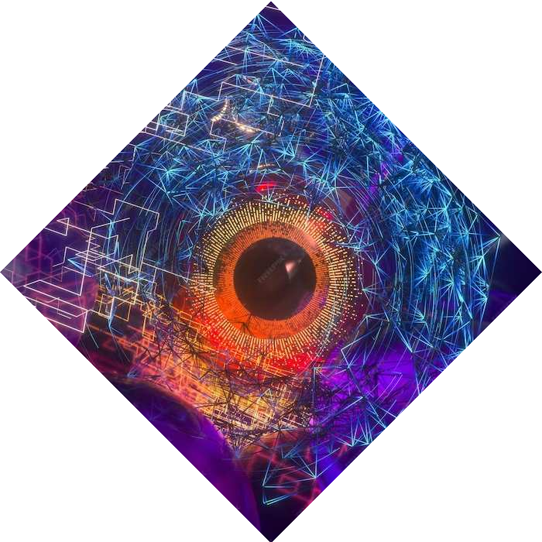
Object Detection in Video Surveillance Systems
Under the Mentorship of
Dr. Pawan Kumar Mishra
Associate Professors
Name - Dikshant Singh Chib
University roll no. - 2021193
Sem - 3rd
Section - C

Slide 2
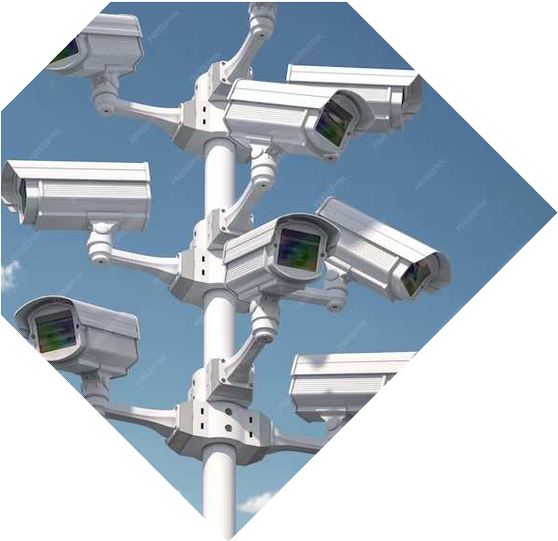
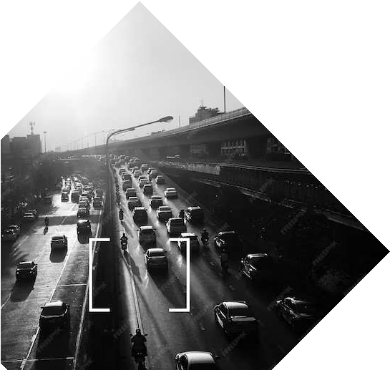
Introduction
In today's world, security is a top priority. Video surveillance systems play a crucial role in ensuring public safety. This presentation will explore the enhancement of these systems through object detection technology.

Slide 3

Object Detection Technology
Object detection is a critical component of video surveillance. It involves the identiﬁcation and tracking of speciﬁc objects within a video feed. This technology enables the system to detect and respond to potential security threats in real
time.

Slide 4
Challenges
Video surveillance systems face challenges such as varying lighting conditions, occlusions, and complex backgrounds. These factors can hinder the accuracy of object detection algorithms, impacting overall system reliability .
Understanding the difficulties, we must overcome while tracking is vital.
Several prevalent and significant obstacles are listed below.
Object occlusion: When an object in a series of photos is obscured or blocked by another object, it becomes challenging to identify the object and to update subsequent images if it resurfaces.
Change of shape: When tracking non-rigid objects, alterations in an object's shape or total deformation frequently result in tracking failure and the inability to detect the object.
False positives: It can be challenging to determine which object is being targeted in subsequent images when there are several similar objects in the scene. It is possible for the tracker to lose sight of the object it is currently tracking and begin tracking something similar

Slide 5
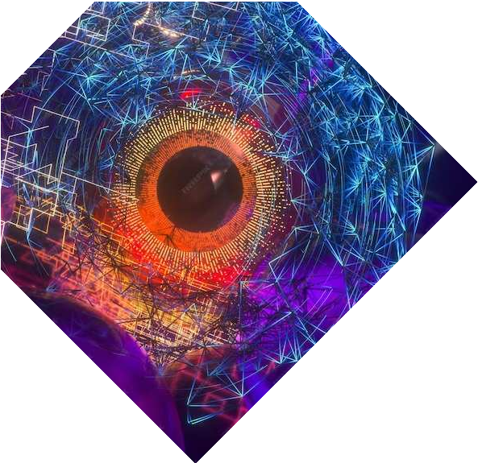
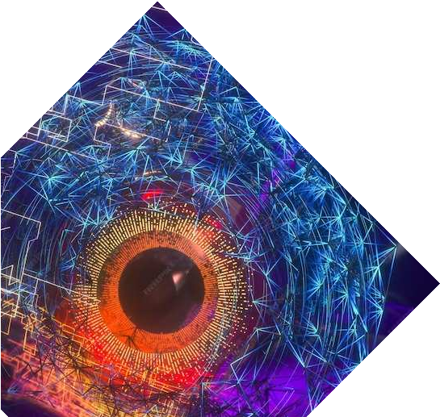
Model and Setup
YOLOv8n Model
The model used in this implementation is YOLOv8n, a variant of the YOLO (You Only Look Once) object detection model. The weights for the YOLOv8n model are loaded from the file "yolov8n.pt".
Dependencies
The implementation utilizes the following libraries:
OpenCV (cv2) for video processing.
NumPy for numerical operations.
Ultralytics for YOLO model integration.
matplotlib. pyplot for plotting graphs

Slide 6
Video Processing
Frame Resizing
The video frames are resized to a width of 640 pixels and a height of 480 pixels for optimized processing.
Object Detection
The YOLOv8n model is used to predict objects in each frame with a confidence threshold of 0.45. Detected objects are then drawn on the frame with bounding boxes, class labels, and confidence scores.
Line Crossing Detection
A horizontal line is drawn on the frame at position 550 pixels. The system counts vehicles that cross this line based on the center of their bounding boxes.

Slide 7
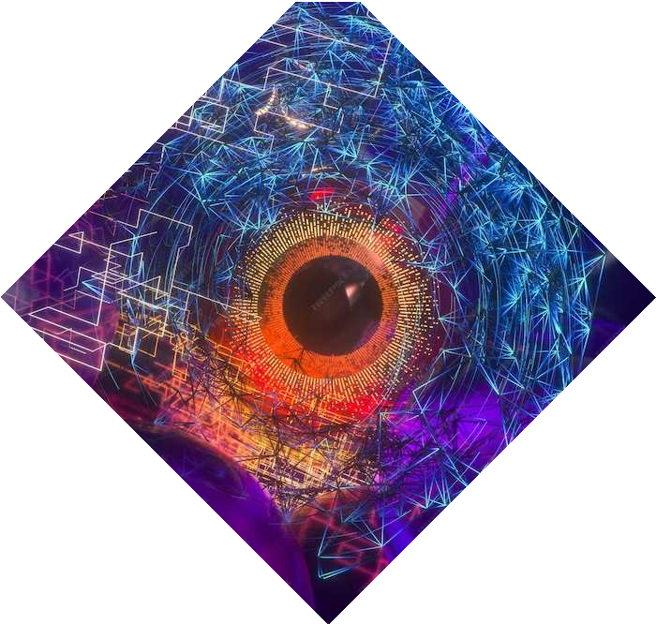
Data Preprocessing
Class List
The class list is loaded from the file "coco.txt" and contains the names of object classes that the model can detect.
Color Generation
Random colors are generated for each class, creating a visually distinguishable set of colors for bounding boxes.

Slide 8
Result
The YOLOv8n deep learning model is used by the implemented Python script to recognize vehicles in real-time within a video stream. The Ultralytics library is used to integrate the YOLOv8n model, which demonstrates effective object recognition skills and provides bounding box visualizations, class labels, and confidence scores.

Slide 9
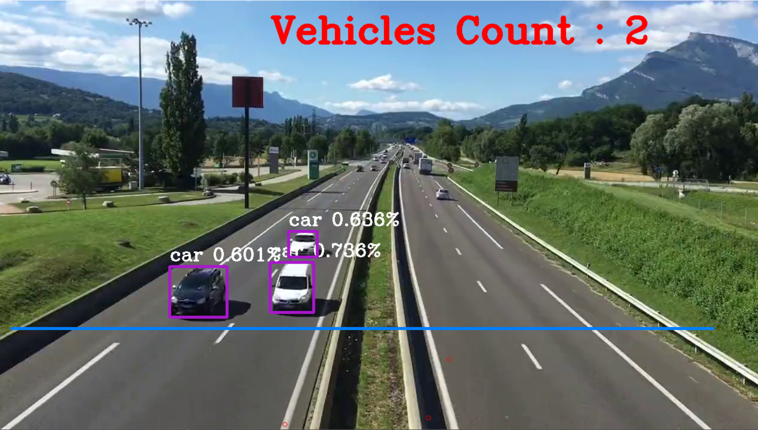
Key Features
Vehicle Counting:
A vehicle counting system built into the script counts how many cars cross a given line in the video.
Each frame shows the counts in real time, and the cumulative counts are charted over time.
Visualizations:
Around identified vehicles, bounding boxes are depicted together with confidence scores and class names.
Marking the centers of bounding boxes adds more spatial information.

Slide 10
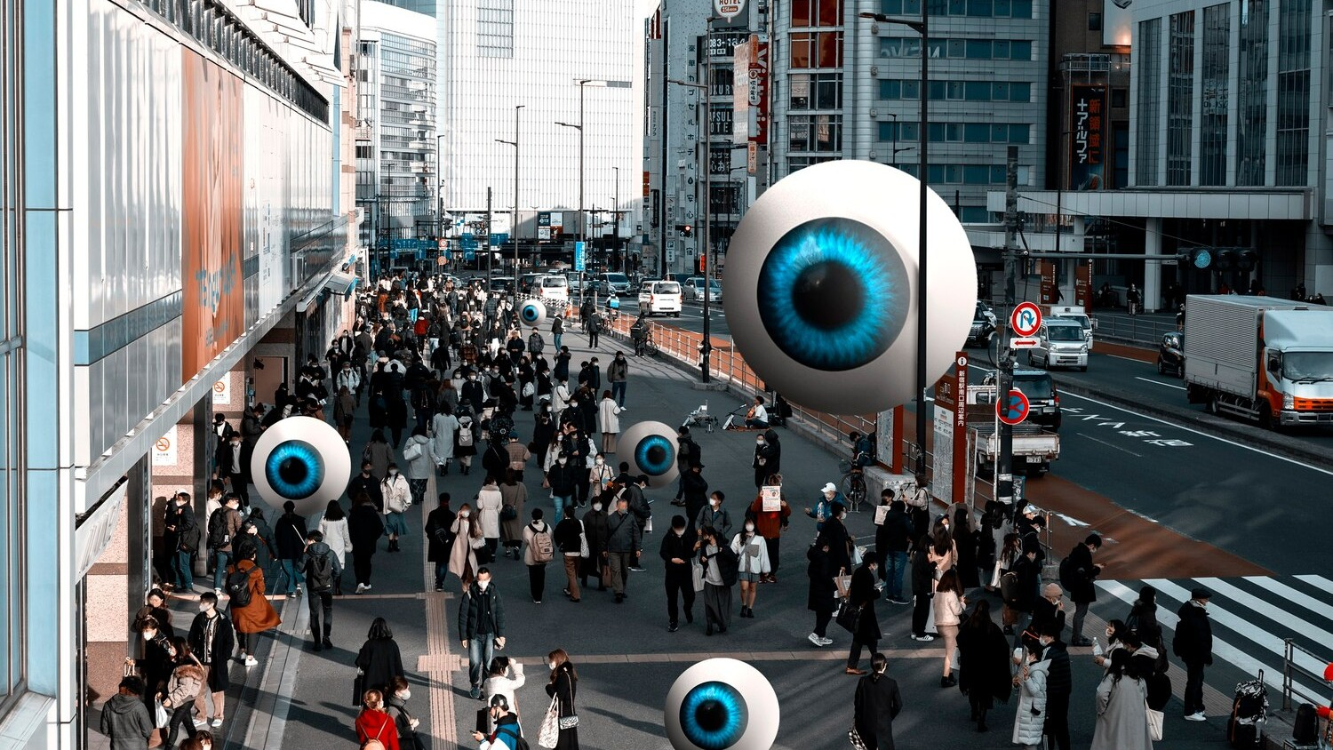
Applications in Public
Safety
Object detection technology has signiﬁcant applications in public safety, including identifying suspicious behavior, monitoring restricted areas, and detecting unattended objects. These applications contribute to proactive
security measures.

Slide 11
Future Developments
The future of object detection in video surveillance systems holds promise for further advancements in accuracy, real- time processing, and integration with other security technologies. These developments will continue to strengthen security measures.

Slide 12
Conclusion
Object detection technology plays a pivotal role in enhancing the eﬀectiveness of video surveillance systems for security. As technology continues to evolve, the integration of advanced algorithms and AI will further improve the capabilities of these systems.

